Slide 1
Strategy of the Week
Skip Strike Call Butterflies
Example Stock: Macy's, Inc (M)

Slide 2
Bull Vertical Call Spread
Bought 20 M Jul 72.50 calls @ 0.94
Sold 20 M Jul 75.00 calls @ 0.44
M Jul72.50-75.00 bull vertical call spread established 0.50 debit 20X
Maximum Value 2.50 @ 75.00 or higher
Minimum Value zero @ 72.50 or lower
Maximum Profit 2.00 ($4,000) @ 75.00 or higher
Maximum Loss 1.16 ($1,000) @ 72.50 or lower

Slide 3
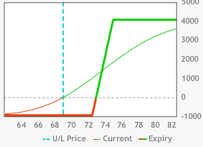
Bull Vertical Call Spread

Slide 4
Bear Vertical Call Spread
Sold 20 M Jul 75.00 calls @ 0.44
Bought 20 M Jul 80.00 calls @ 0.11
M Jun 75.00-80.00 bear vertical call spread established 0.33credit
Maximum Value 5.00 @ 80.00 or higher
Minimum Value zero @ 75.00 or lower
Maximum Profit 0.33 ($660) @ 75.00 or lower
Maximum Loss 4.03 ($9,340) @ 80.00 or higher

Slide 5
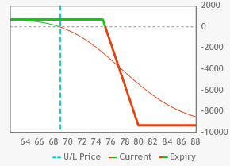
Bear Vertical Call Spread

Slide 6
Skip Strike Call Butterfly
M Jul72.50-75.00 bull vertical call spread established 0.50 debit 20X
M Jun 80.00-75.00 bear vertical call spread established 0.33 credit 20X
Maximum Profit $4,660 @ 75.00
Maximum Upside Loss $5,340 @ 80.00 or higher
Maximum Downside Loss $340 @ 72.50 or lower

Slide 7
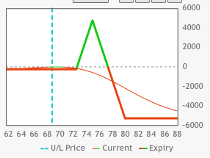
Skip Strike Call Butterfly

Slide 8
Q&A
Email your questions to
dan@optionthinker.com

